Slide 1
Text
RC Car 2.0

Slide 2
RC CAR 2 System Overview
RC Car Expand
Laptop Driven TX
Avoid impossible/ dangerous commands
Text
Path defined
Convert to car controls
Send from Laptop to Hardware
PWM to inputs
TX to Car
USB to TTL? TX HW on USB dongle? Rasp Pi Pico
GUI? CLI/Text Based
Steering % Time Driving % Time
What voltage reqd. What current source reqd.

Slide 3
RC CAR 2 System Overview v1.0
Text
Pi Pico
Repurposed TX parts
USB interface
Button Logic
Transceiver
Antennae
Power
+5V
+3V

Slide 4
RC CAR 2
Text
5V
3V3
0V
Pico
TX
USB
IO
Buttons

Slide 5
RC CAR 2
Text
State | Physical | Digital (Pico) |  | TX | Pico
A | Off | Off |  | High (internal pull up?) | High (3V) (sourcing current) | 3V3 from pi to TX
B | Off | On |  | Low (Sourcing current) | Sinking current (protection needed?) | Sink current?
C | On | Off |  | Low (Sourcing current) | Sourcing current to GND (Protection needed) | Short from pi 3V3 to 0V?
D | On | On |  | Low (Sourcing current) | Sinking current (In parallel with switch) | Sink current should be less than State B

Slide 6
RC CAR 2
Text

Slide 7
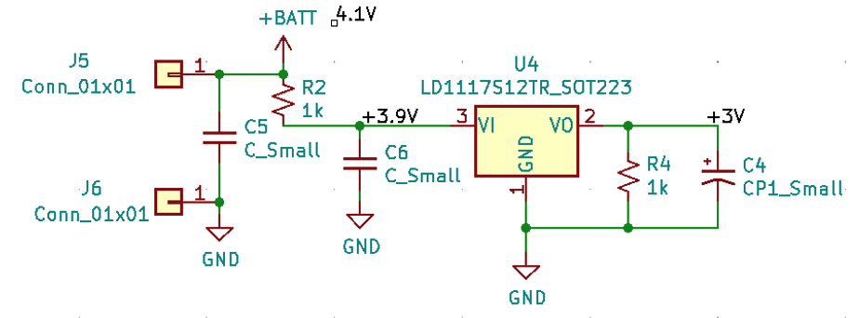
RC CAR 2 System Overview v1.1
Self Made USB interface
Repurposed TX parts
Text
USB interface
Button Logic
Transceiver
Antennae
Power
+5V
+3V
LDO Like V?
HIDAPI?

Slide 8
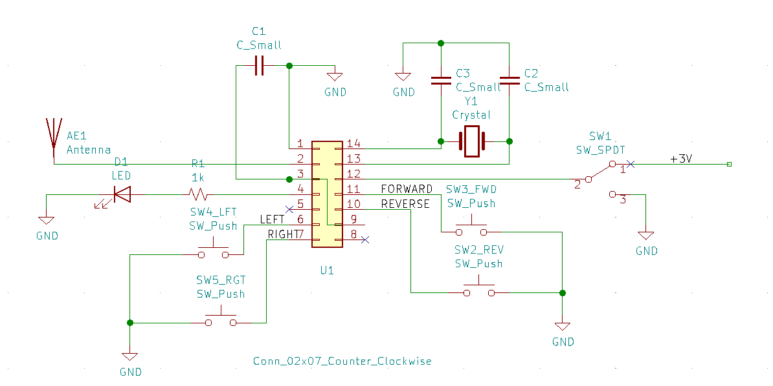
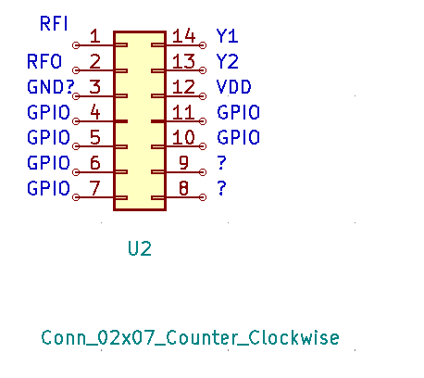
RC CAR 2 TX Circuitry
What capacitor values are used?
IOVDD Set to 3V0?
What Vin can U1 handle?
Bypass and use VCC from pi
NC tac switch for reset?
Likelihood of Antenna being transferrable?
Text
What type of IC is U1?
Controlled through GPIO
Is PWM needed or overkill?
U1 inputs are using internal pullups
Pi O/P to be normally high, and switch low to “press button”

Slide 9
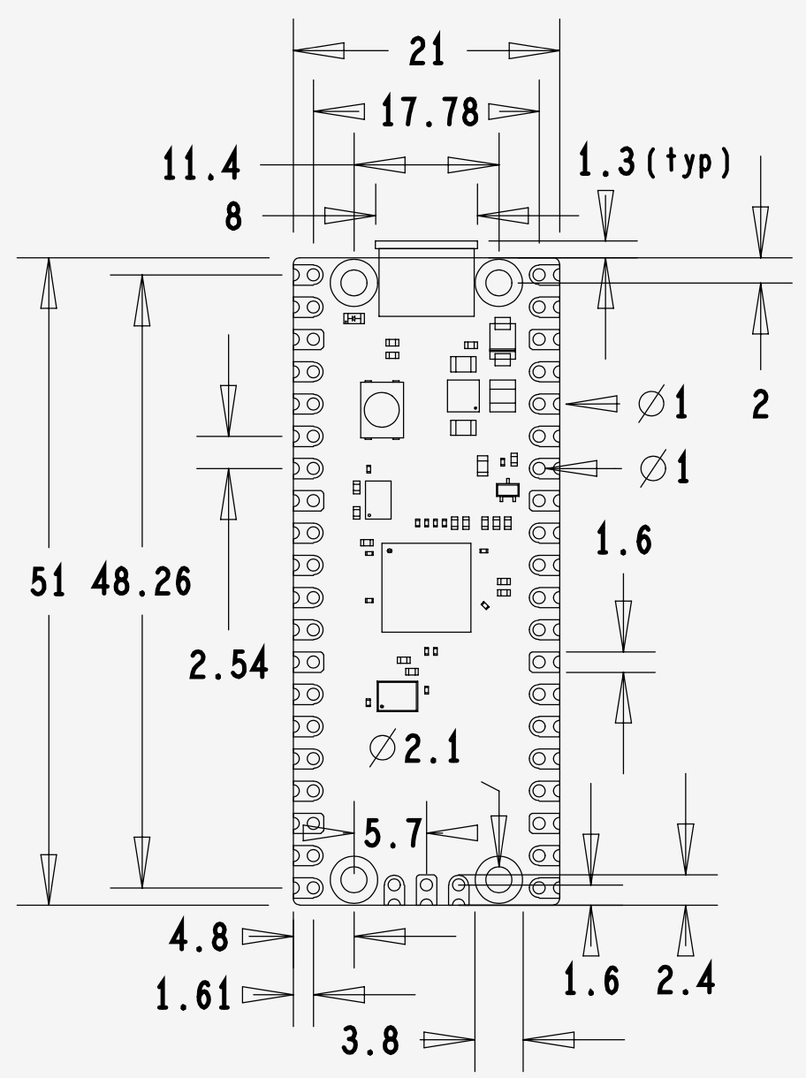
RC CAR 2 Pico pi Reference
Text
The Raspberry Pi Pico is a single sided 51x21mm 1mm thick PCB with a micro-USB port overhanging the top edge and dual castellated/through-hole pins around the remaining edges. Pico is designed to be usable as a surface mount module as well as being in Dual Inline Package (DIP) type format, with the 40 main user pins on a 2.54mm (0.1") pitch grid with 1mm holes and hence compatible with veroboard and breadboard. Pico also has 4x 2.1mm (+/- 0.05mm) drilled mounting holes to provide for mechanical fixing, see Figure 3.

Slide 10
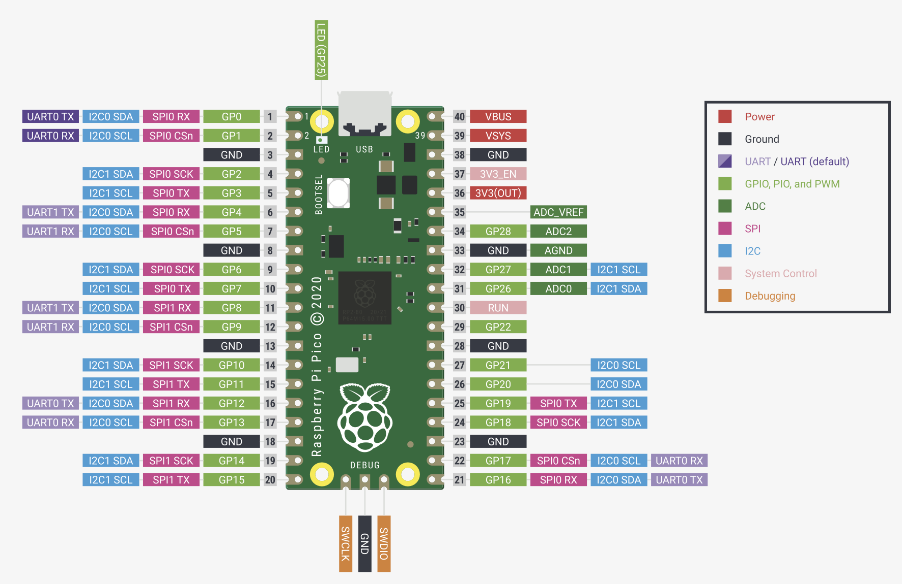
RC CAR 2
GP0
GP1
GP2
GP3
Text

Slide 11
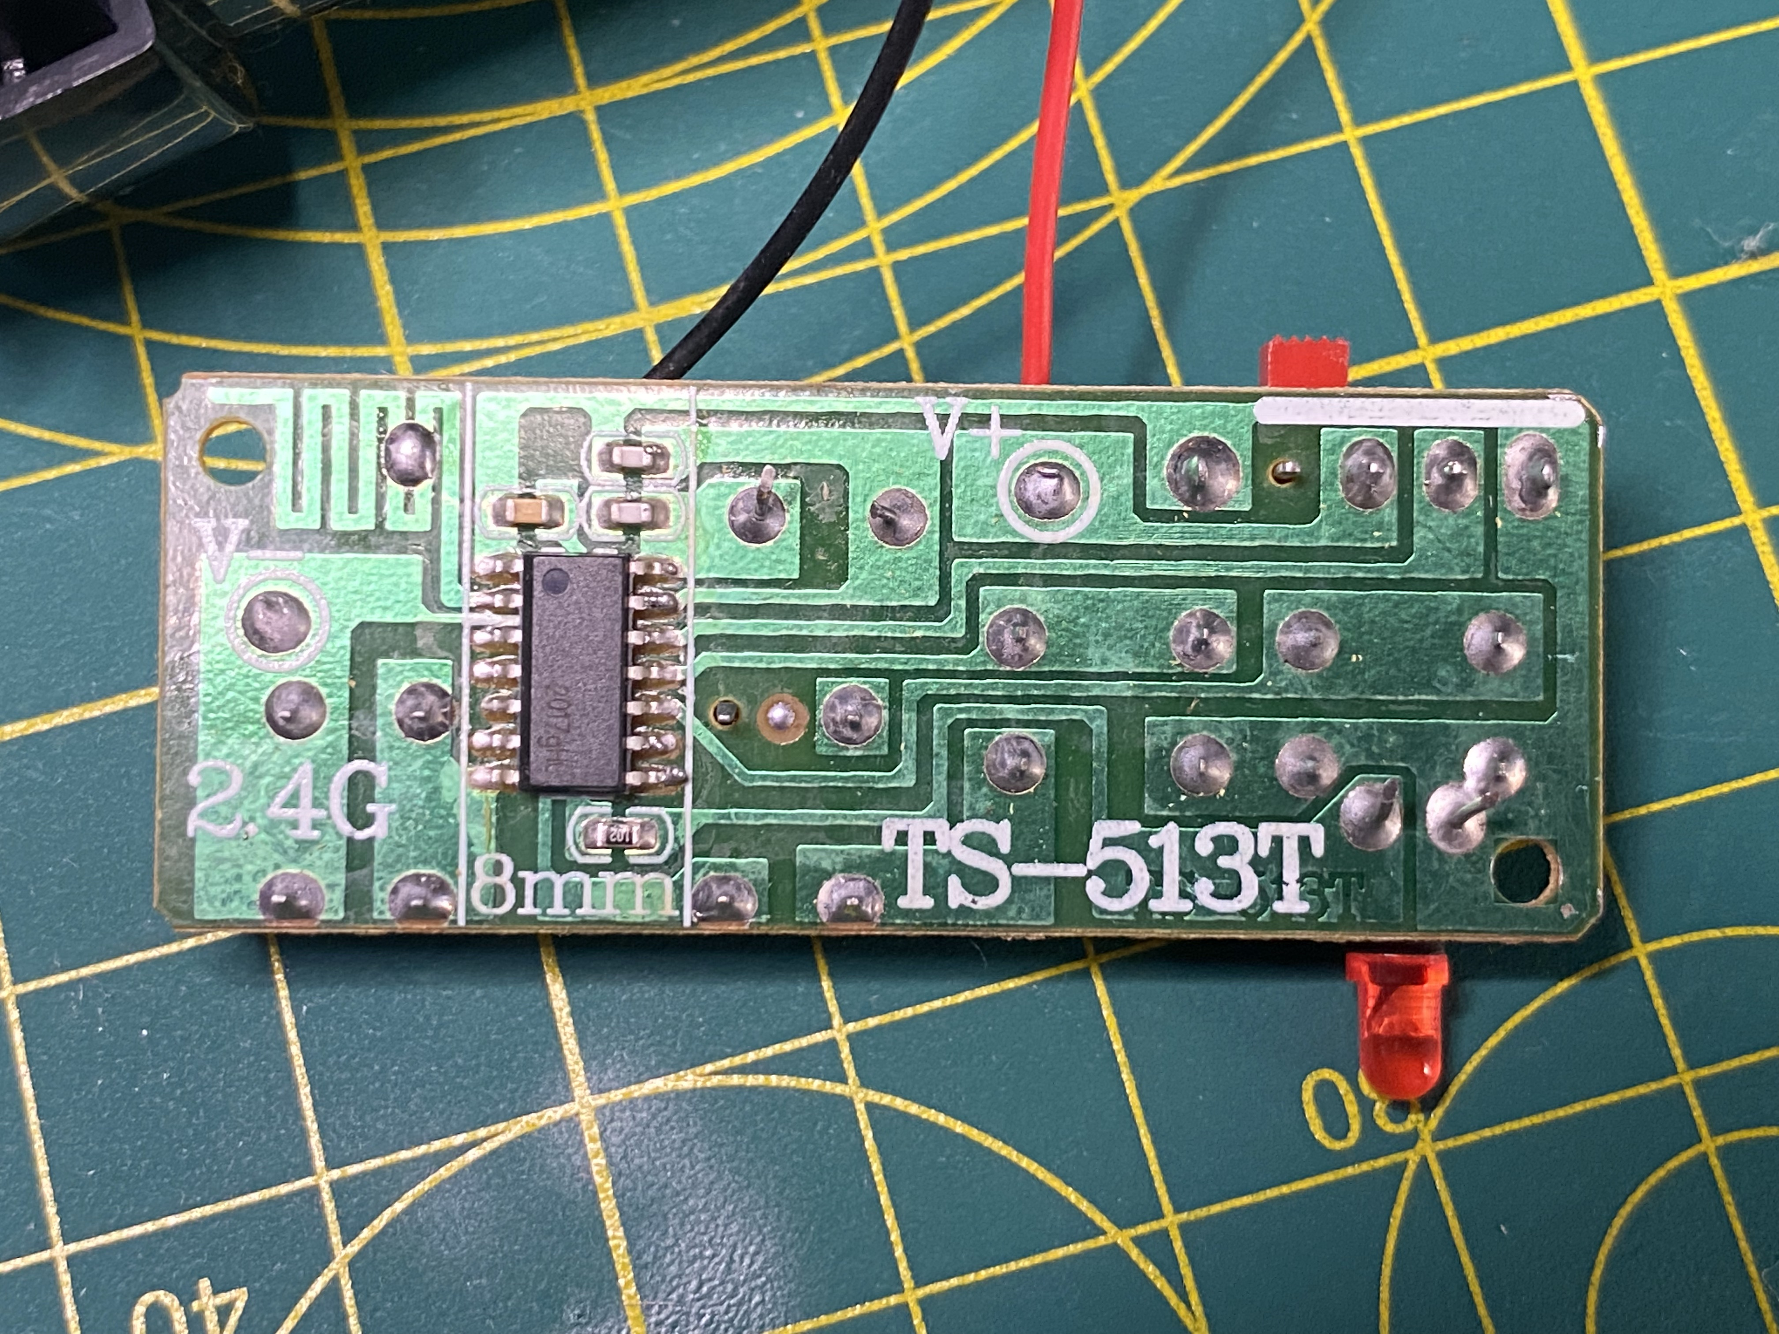
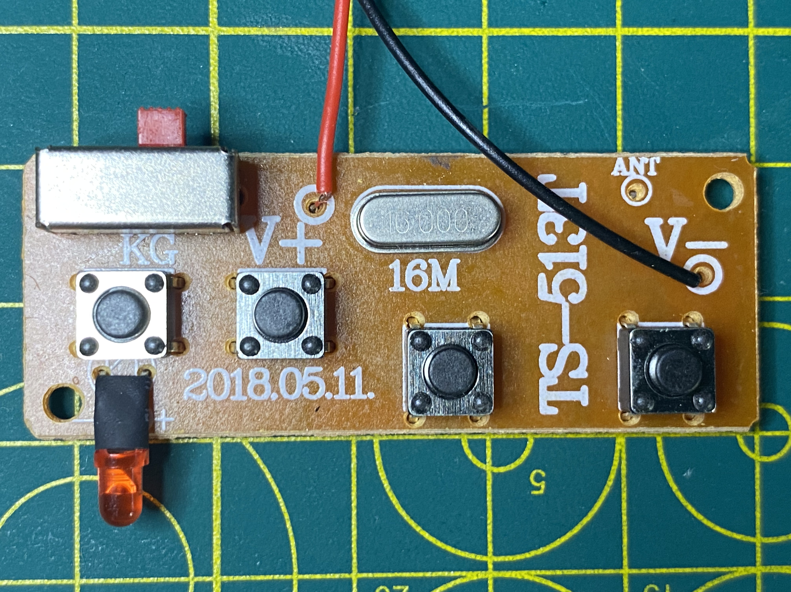
RC CAR 2 TX Interface
PCBA | Direction | Pico
SW2 | REVERSE | GP1
SW3 | FORWARD | GP0
SW4 | LEFT | GP2
SW5 | RIGHT | GP3
Pull switch to GND to trigger
Text
SW3
SW2
SW5
SW4

Slide 12
RC CAR 2 POC SW
Initialise pico pi
4 GPIOs
Output
Normally set High
Active set Low
Left and Right mutually excl
Front and Back mutually excl
LED
Signal on
Flash twice for starting first stage
Flash thrice for starting second stage
Test cycle
Forward pulse
Left pulse
Back pulse
Right pulse
Forward and left
Forward and right
Back and left
Back and right
Text

Slide 13
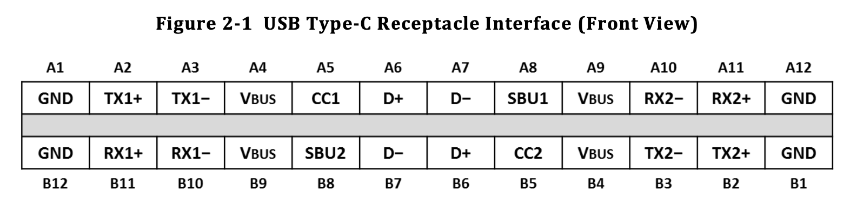
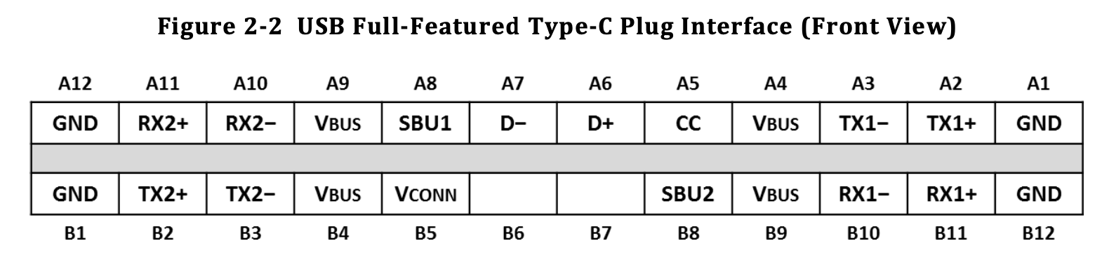
RC CAR 2
Text
Text

Slide 14
RC CAR 2
Text

Slide 15
RC CAR 2
Text

